Slide 1
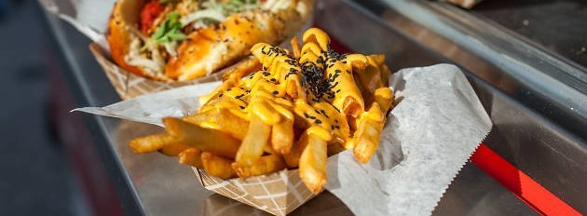
Food Truck Tinder
An App for Food Truck Foodies and Vendors

Slide 2
Elevator Pitch
Have you ever been out with friends and wondered “Where can I find a food truck near me?” and didn’t know how to find any? Well, look no further than the Food Truck Tinder app! Just open it up and any available food trucks near you can be found.
Own a food truck and don’t know how to quickly advertise your location? Food Truck Tinder is your solution! Check your truck in and your information and location will be immediately available for customers to find.

Slide 3
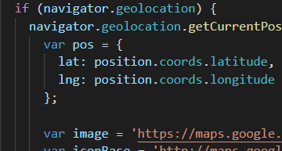
Concept
An application for the food truck enthusiast to quickly find food trucks in their vicinity.
It also allows food truck businesses to provide their location for easy locating by enthusiasts, thereby increasing foot-traffic.
One-stop shop for food trucks.

Slide 4
The Story
User story:
AS A food truck enthusiast,
I WANT to see where and when food trucks are available,
SO THAT I can pick a truck to eat at.
Food Truck Owner:
AS A food truck owner,
I WANT customers to know where I'm located,
SO THAT I can increase my food sales.

Slide 5
Process
Technologies used:
HTML
CSS
JavaScript
jQuery
Materialize
APIs
Google Maps
Tripadvisor
Firebase Realtime Database
Breakdown of tasks:
Max
Google Maps
Firebase
Kathryn
Tripadvisor
Jesse
Materialize
CSS
All
HTML
JavaScript
jQuery
Challenges:
Scoping
Working with new APIs and figuring out how they can work together.
Research took a bulk of the time

Slide 6
Demo

Slide 7
Directions for future development
For future development:
Pre-ordering to streamline order queue
Provide link to car service
E.g. UberEats, Doordash.
Menu when user clicks truck icon

Slide 8
Links
Deployed: https://katgrace0808.github.io/Tinder-for-Food-Trucks/
GitHub: https://github.com/katgrace0808/Tinder-for-Food-Trucks

